Slide 1


Created by
Pallavi Uike & Minal Mane

Slide 2

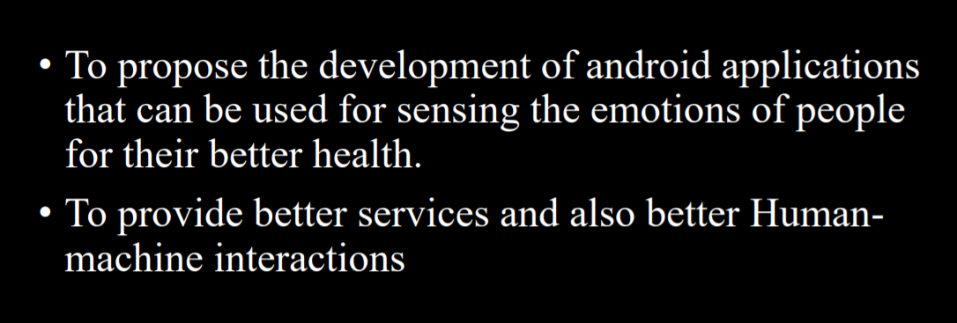

Slide 3

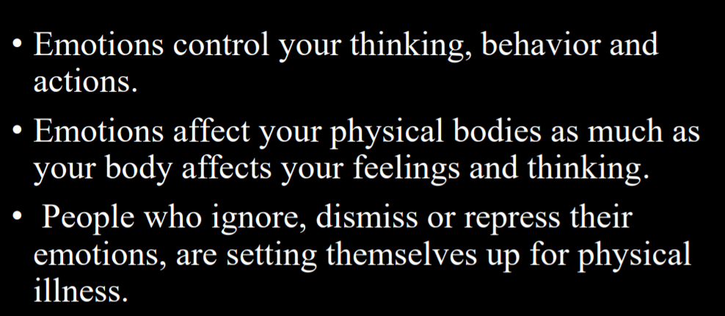

Slide 4

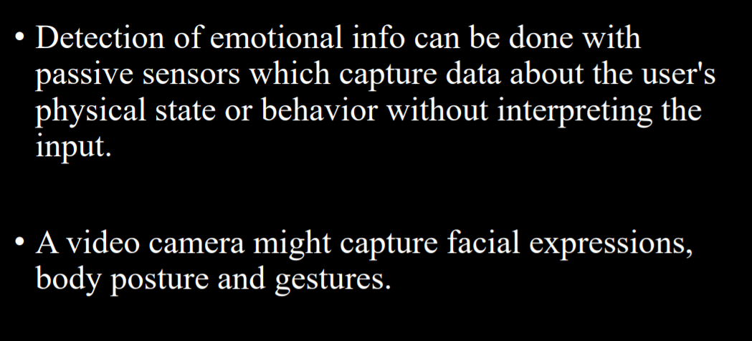

Slide 5

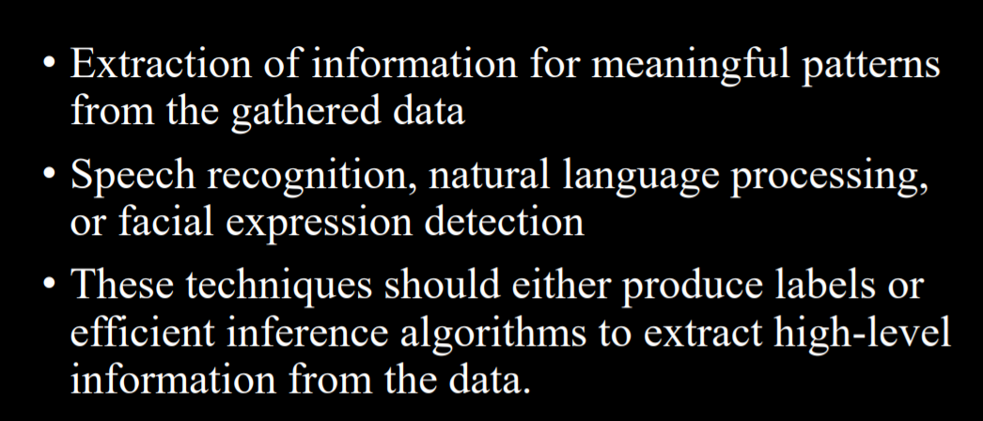

Slide 6

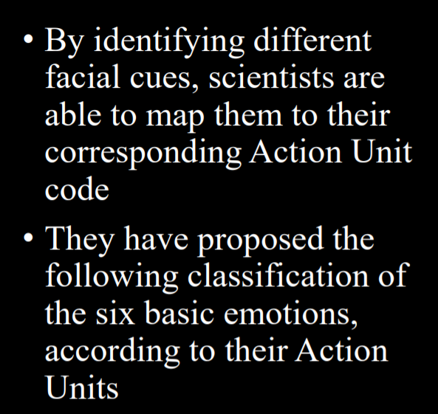
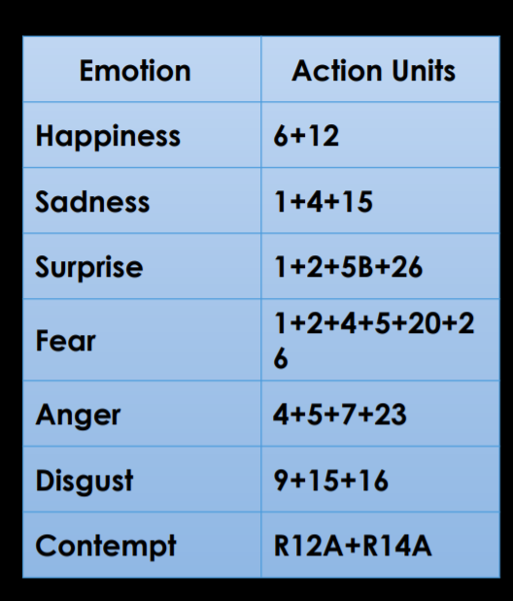

Slide 7
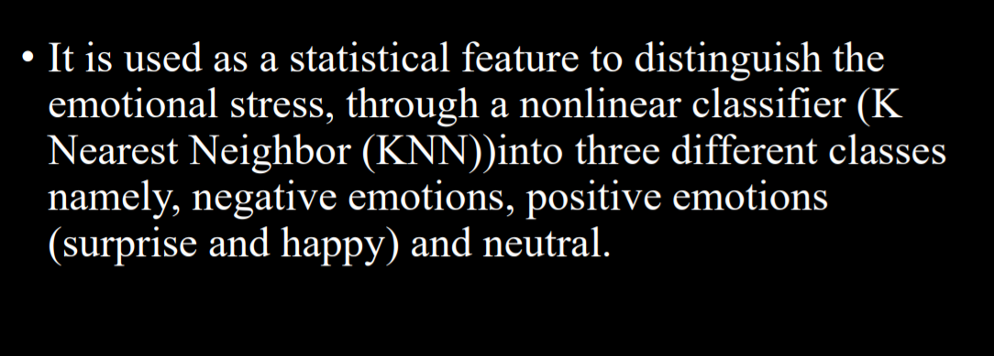

Slide 8

To understand the emotions with the help of Web Cam will help in achieving greater success in the lives of people.

Slide 9


